Slide 1


AWS Secrets Manager
Securely Manage, Rotate, and Retrieve Credentials

Slide 2
Introduction
The modern standard for sensitive data protection

Slide 3


WHAT IS SECRETS MANAGER?
Centralized Vault
Automated Lifecycle
Protected storage for database credentials, API keys, and OAuth tokens. Replaces insecure configuration files and environment variables.
Enables the automated rotation of secrets without application downtime, enhancing your security posture through credential freshness.

Slide 4


THE PROBLEM: HARDCODED SECRETS
Security Risk: Plaintext credentials in code repositories lead to massive breaches.
Stale Data: Manual rotation is tedious, error-prone, and rarely performed.
Lack of Audit: Hard to track who accessed which credential and when.

Slide 5






KEY CAPABILITIES
Rotation
Access Control
Encryption
Native integration with AWS Lambda to rotate credentials automatically.
Fine-grained IAM policies for precise permission management.
Uses AWS KMS to encrypt secrets at rest with hardware security modules.

Slide 6
Deep Dive: Rotation
Eliminating the risk of long-lived credentials

Slide 7

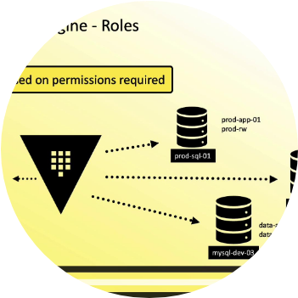
AUTOMATED SECRET ROTATION
How It Works
Secrets Manager uses an AWS Lambda function to update the credential in the target service (like RDS) and then updates the secret value in the vault.
Supports RDS, Redshift, and DocumentDB natively.
Customizable for any third-party API or service.

Slide 8

SECURITY & KMS
Uncompromising Protection
Every secret is encrypted using a unique data key from AWS Key Management Service (KMS). This ensures that even if physical storage were compromised, your data remains unreadable.
Integration with CloudTrail provides a complete audit log of every retrieval and rotation attempt, satisfying strict compliance requirements like PCI-DSS and HIPAA.

Slide 9
FINE-GRAINED ACCESS CONTROL
Identity-Based Policies: Attach to IAM users or roles to define who can read or update secrets.
Resource-Based Policies: Attach directly to the secret to allow cross-account access or restrict to specific VPCs.
KMS Permissions: Users must have permission to both the secret AND the KMS key to decrypt the value.
VPC Endpoints: Access Secrets Manager privately without traversing the public internet.

Slide 10



THE SECRET LIFECYCLE
Store
Rotate
Versioned storage in vault.
Lambda updates value periodically.
Create
Retrieve
Define secret and encryption key.
App fetches at runtime via API.

Slide 11









COMMON USE CASES
DB Credentials
API Keys
SSH/Keys
Seamlessly manage RDS and Aurora logins.
Secure third-party keys like Stripe or Twilio.
Centralize infrastructure access management.

Slide 12
SECRETS MANAGER VS PARAMETER STORE
Feature | Secrets Manager | Parameter Store (Secure)
Automatic Rotation | Built-in with Lambda templates | Manual or custom implementation
Cross-Account Access | Easier (Resource-based policies) | Complex (IAM roles)
Cost | $0.40 per secret / month | Standard parameters are Free
Replication | Native multi-region support | Manual copy needed

Slide 13

HIGH AVAILABILITY & SCALE
Performance Reliability
Secrets Manager is designed for high-concurrency environments, supporting thousands of requests per second for global applications.

Slide 14

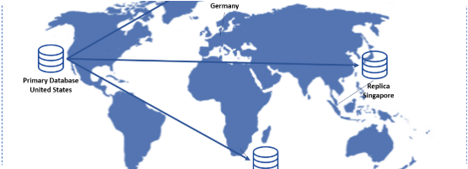
PRICING & REPLICATION
Global Secret Replication
AWS Secrets Manager supports replication across multiple regions to ensure your secrets are available for multi-region applications and disaster recovery scenarios.
$0.40
Per Secret Per Month

